Slide 1
Programming in Python

Slide 2
Today we will be covering
Python Overview
Python Environment Setup
Writing First Python Program
Introduction to Data Types in Python

Slide 3
What can I do in python ?
Web and Internet Development
Data Science and Machine Learning
Scientific and Numeric Computation
Software Development and GUI

Slide 4




Companies that use Python for development
Facebook: Largely to process images and Machine learning. Instagram : The company has recently moved to Python 3.
Spotify: Spotify also trusts Python and applies it in its back-end services, as well as for data analysis purposes.
Amazon: To give accurate recommendation to its users, Amazon uses Python machine learning engine.

Slide 5
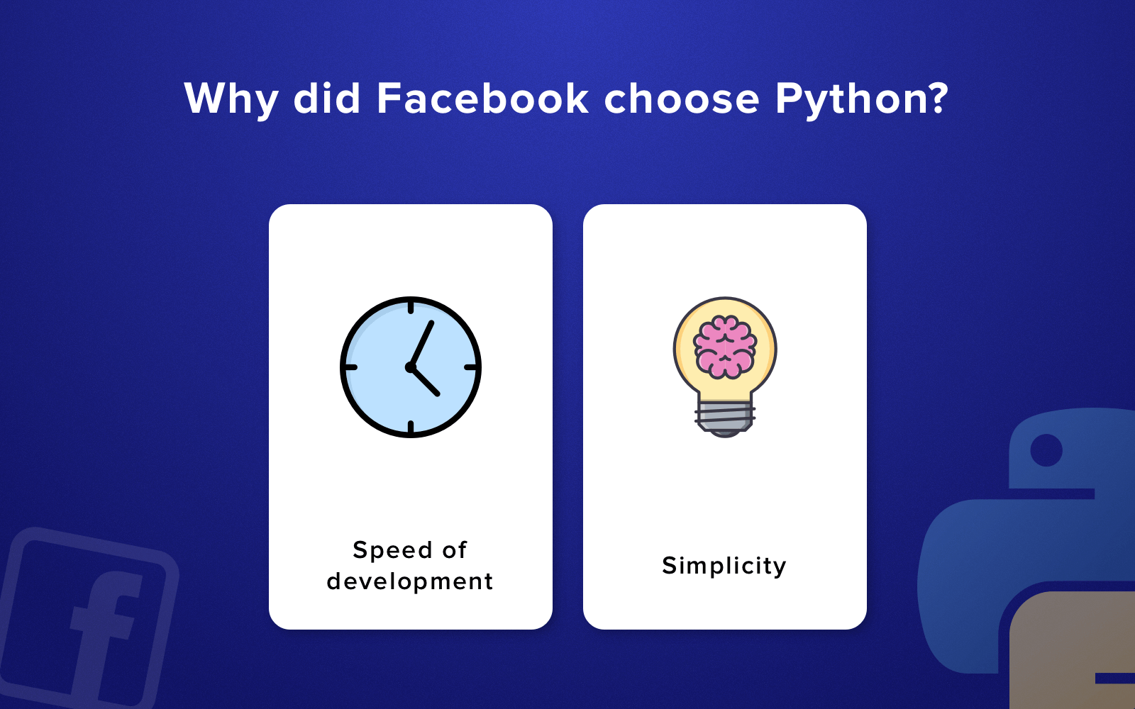
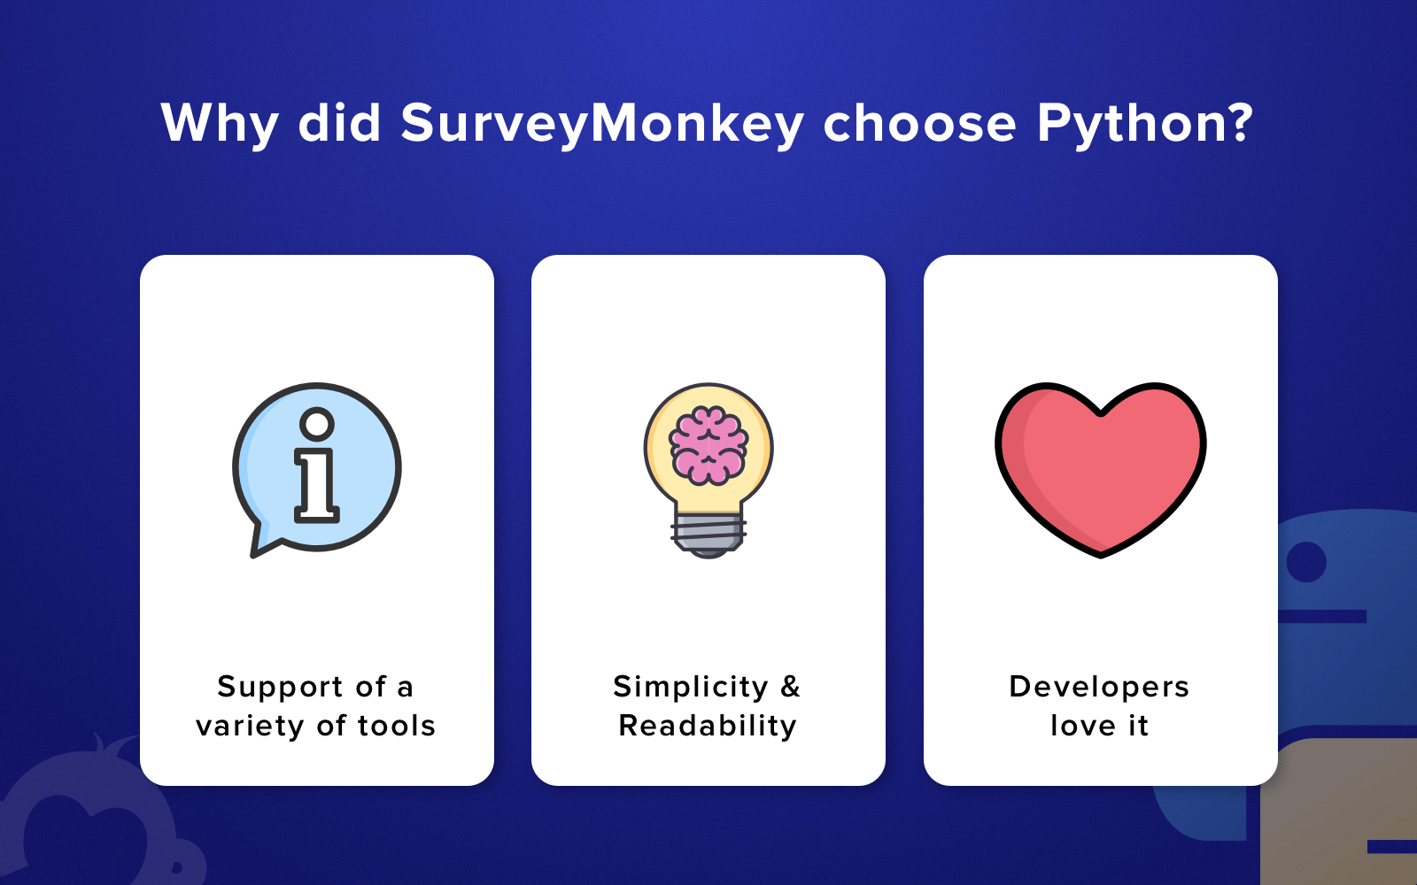
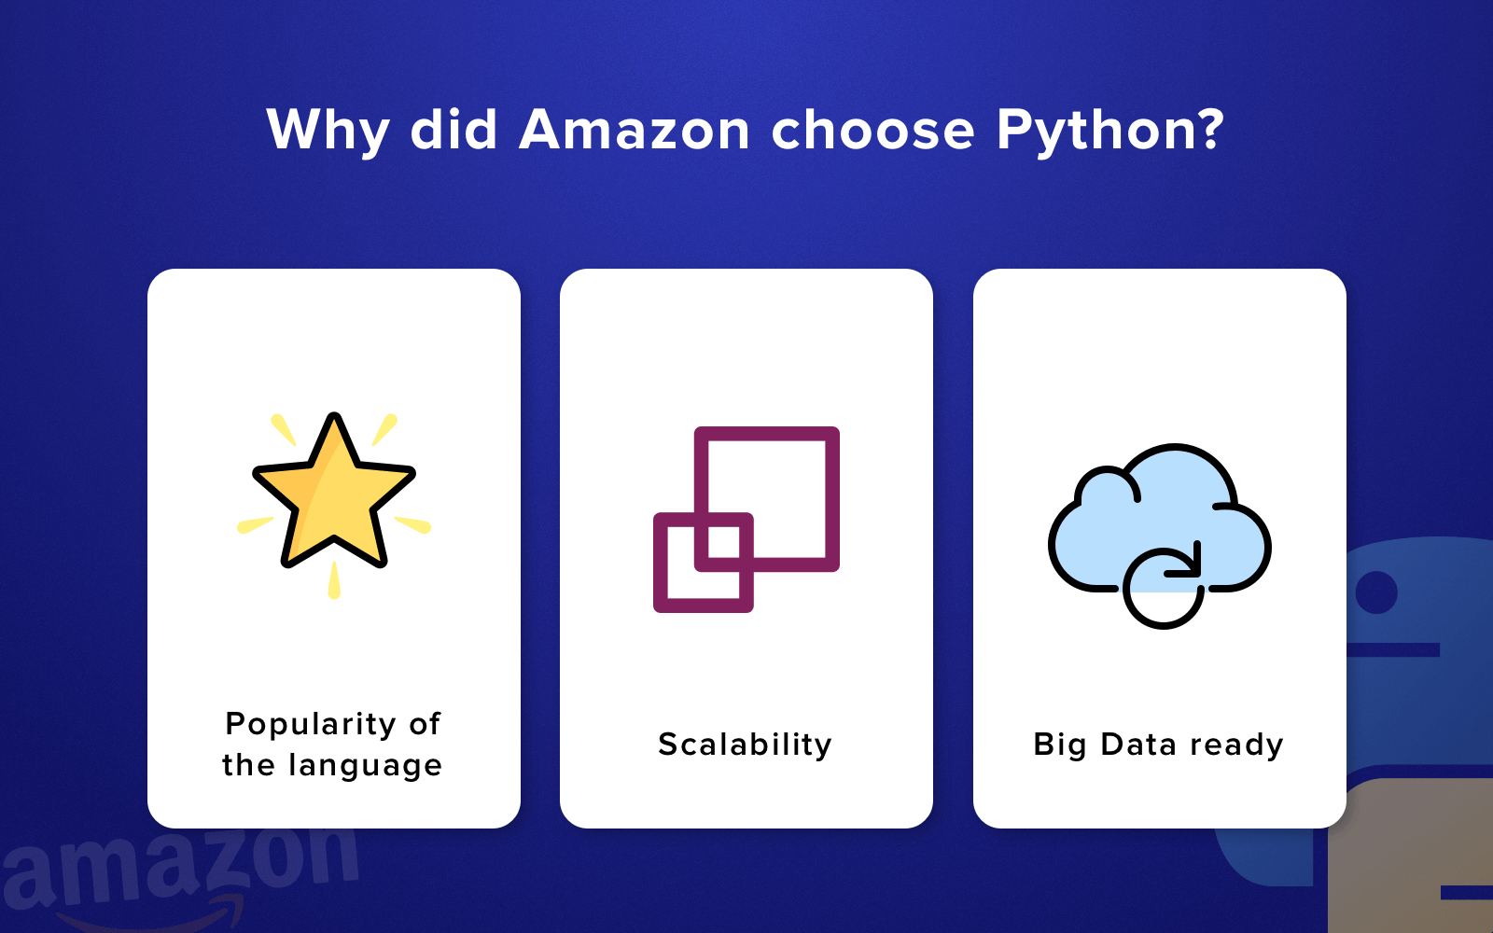
Why Companies choose Python language ?

Slide 6
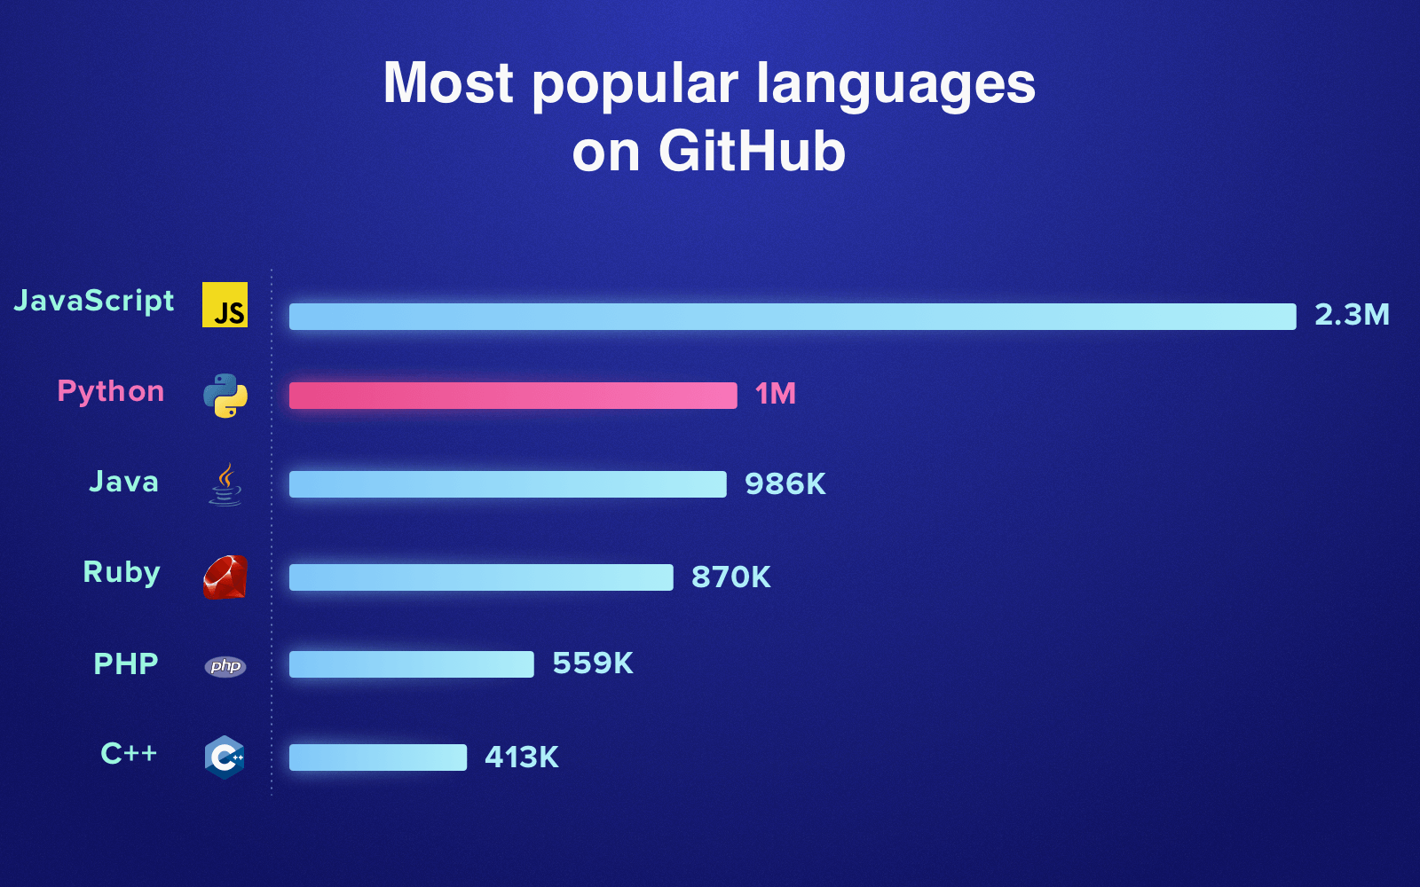
And you are definitely not alone

Slide 7
What is Python ?
Python is a high-level, interpreted, and object oriented scripting language.
High Level Language: enables a programmer to write programs that are more or less independent of a particular type of computer.
Interpreted − Python is processed line by line at runtime.
Object-Oriented − Python supports Object-Oriented style .

Slide 8
Python 2 or Python 3?
“Python 2.x is legacy, Python 3.x is the present and future of the language”
Which version should I use? Which version you ought to use is mostly dependent on what you want to get done. If you can do exactly what you want with Python 3.x, great! There are a few minor downsides, such as very slightly worse library support and the fact that some current Linux distributions and Macs still use 2.x as default, but as a language Python 3.x is definitely mature and ready for use.
Notes:
https://wiki.python.org/moin/Python2orPython3

Slide 9
Local Environment Setup
Go to https://www.anaconda.com/download/
Choose your Operating System(Windows, Mac or Linux) and Click on Download. It will automatically download Anaconda application on your system. Now install the application.
Once installed, go to command prompt(windows) or terminal(Mac and Linux) and type python. If you see any errors, then python is not installed properly in your system. Otherwise you are good to go.

Slide 10






Now it’s time to write some code
We can write code in any text editor provided we tell the computer that it is code file, that usually happens with the file extension. For python the file extension is .py
Now my personal favourite is Atom, but you can go with Sublime text, Notepad++, Coda, Emacs etc.
We can also switch to platforms called IDE - Interactive Development Environment. Eg Pycharm

Slide 11
Let’s get started then
Open text editor.
Create a new python file with the extension of (.py)
print(“Hello World!”)
Save it.
Open Command Prompt and go to the folder where the file is located.
Run the script by typing python name_of_the_file.py
And that’s it.

Slide 12
Basic Syntax(Python Identifiers)
Name used to identify.
Variable
Function
Class / Module
And other object etc.
An identifier starts with a letter A to Z or a to z or an underscore (_) followed by zero or more letters, underscores and digits (0 to 9).
Python does not allow Special characters such as @, $, and % within identifiers.
Python is a case sensitive programming language.

Slide 13
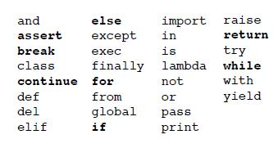
Basic Syntax(Keywords)
These are reserved words and we cannot use them as constants or variables or any other identifier names.

Slide 14
Basic Syntax(Indentation)
Unlike other programming languages, python does not use braces (), [ ], { } to indicate blocks of code.
Block of code is denoted with indentation. Within a block of code, every statement will have same indentation.
# This is a comment
i = 0
while i < 5:
print(i)
i = i+1

Slide 15
Basic Syntax(Variables)
Variable is a placeholder in programming.
In a layman terms, it is name given to a memory space so that It can be called whenever needed.
We can assign values to the variable by using assignment operator(=)
# This is a comment
var = 10
_var2 = 3.14287
var3 = “hello world!”
# We can do multiple assignments too
a, b, c = 100, 1.21, “Sentence”
a = b = c = 3.14159

Slide 16
Data Types in Python
Numbers
String
List
Tuple
Dictionary

Slide 17
Data Types in Python(Numbers)
Store numeric values.
Are of three types
int (signed integers)
float (floating point real values)
complex (complex numbers)
# Types of Numbers
A = 10
B = 3.14159
C = 2 + 5j

Slide 18
Data Types in Python(String)
Store contiguous set of characters enclosed in the quotation marks(single quotation or double quotation).
Start with index 0.
Can be accessed using slice operator ([ ] and [:] )
# String in Python
A = “Hey there”
print(A) #Hey there
print(A[1:]) #ey there
print(A[1:5] #ey t
print(A*2) #Hey thereHey There
print(A + “ Mohit”) #Hey there Mohit

Slide 19
Data Types in Python(List)
A list is a collection of items(which may or may not be of same data types) separated by commas and enclosed within square brackets [ ].
Start with index 0.
Can be accessed using slice operator ([ ] and [:] )
# List in Python
Mylist = [‘cow’, 1.23, 11, “batman”]
print(A) #[‘cow’, 1.23, 11, “batman”]
print(A[1:]) #[1.23, 11, “batman”]
print(A[2] #[11]
print(A*2) #[‘cow’, 1.23, 11, “batman”, ‘cow’, 1.23, 11, “batman”]
secondlist = [21, ‘dog’]
print(A + secondList) #[‘cow’, 1.23, 11, “batman”, 21, ‘dog’]

Slide 20
Data Types in Python(tuples)
Data type that is similar to the list.
A tuple is a collection of items(which may or may not be of same data types) separated by commas and enclosed within square parenthesis ( ).
Start with index 0.
Can be accessed using slice operator ([ ] and [:] )
Can be thought of as read-only list. It’s elements cannot be updated

Slide 21
Data Types in Python(Dictionary)
A Dictionary is just like a hash table(or map in C++ and Java)
Every element is of type (key, value) pair
Enclosed in curly braces { }
#dictionary in C++
dict = {}
dict['mohit'] = ‘Sharma’
print(dict['mohit']) #Sharma

Slide 22
Basic Operators in Python
Arithmetic Operators
Relational Operators
Bitwise Operators
Assignment Operators

Slide 23
Basic Operators in Python (Arithmetic Operator)
Addition(+)
Subtraction(-)
Multiplication(*)
Division(/)
Remainder(%)
Floor Division(//)
Exponential (**)
# Arithmetic Operators in Python
a = 55
b = 10
res = 0
res = a + b
print res
res = a - b
print res
res = a * b
print res
res = a / b
print res
res = a % b
print res
res = a // b
print res
res = a ** b
print res

Slide 24
Basic Operators in Python (Relational Operator)
==, !=, < , > , <= , >=
# Relational Operators in Python
a = 55
b = 10
res = 0
res = (a == b)
print res
res = (a != b)
print res
res = (a < b)
Print res
res = (a > b)
print res
res = (a <= b)
print res
res = (a >= b)
print res

Slide 25
Basic Operators in Python (Assignment Operator)
=, +=, -= , *= , /= , %=, //=
# Assignment Operators in Python
a = 55
res = 0
res = a
print res
res += a
print res
res -= a
print res
res *= a
print res
res /= a
print res
res %= a
print res

Slide 26
Basic Operators in Python (Bitwise Operator)
# Bitwise Operators in Python
a = 79 # 79 = 0100 1111
b = 21 # 21 = 0001 0101
res = 0
res = a & b; # 5 = 0000 0101
print res
res = a | b; # 95 = 0101 1111
print res
res = a ^ b; # 90 = 0101 1010
print res
res = ~a; # -79 = 1011 0000
print res
res = a << 2; # 60 = 0011 1100
print res
res = a >> 2; # 19 = 0001 0011
print res
Binary AND(&)
Binary OR(|)
Binary XOR(^)
Binary Ones Complement (~)
Binary Left Shift (<<)
Binary Right Shift (>>)

Slide 27
Python Input and Output
# Input Output in Python 2
# In Python 2.x, you need to use raw_input()
var = raw_input()
print var
# Give a helpful hint during the prompt
name = input("Enter your Name")
print name
# Input Output in Python 3
# In Python 3.x, you need to use input()
var = input()
print (var)
# Give a helpful hint during the prompt
name = input("Enter your Name")
print (name)

Slide 28
Let’s start working on our Project: Spychat

Slide 29
Well, what features should our SpyChat application have?
Profile of a spy
A menu of choices
Status message for a spy
Add a spy friend
Send and read a secret message
Save chats

Slide 30
Profile of SpyChat
Step 1: Create a project folder. Inside the project folder, we will have 2 files(main.py and default.py). So create these two files.
Step 2: Inside the main.py, we will keep our main program. Our objective is to create the profile of a spy. This is the same just like we create our profile on Facebook or Google.

Slide 31
Profile of SpyChat(Collecting Data)
Step 3: Let’s assume that we are going to ask the following details from every spy.
Name of spy spy_name = input("Enter your Name: ")
Salutation(Mr. or Mrs.) spy_salutation = input("Enter your Salutation (Mr. or Mrs.): ")
Age spy_age = input("Enter your age: ")
Rating(A or B or C) spy_rating = input("Enter your rating: ")

Slide 32
Profile of SpyChat(Validating the name)
Step 4: We have to ensure that user has not entered invalid name. Otherwise our program must print appropriate message and exit. Clearly name should only alphabets (A-Z, a-z) and at least one character. To check it, we will use isalpha() function. This method returns true if all characters in the string are alphabetic and there is at least one character, false otherwise.
sys.exit(0) function is used to exit main function in the middle. But we must add import sys statement in our first line.
#Validating the name of the spy
if spy_name.isalpha() == False:
print("Name is Invalid")
sys.exit(0)

Slide 33
Profile of SpyChat(Validating the age)
Step 5: We have to ensure that age of the spy should be greater than 12 and less than 50. Otherwise our program must print appropriate message and exit.
#Validating the age of the spy
if int(spy_age) <= 12:
print("Age below 12")
sys.exit(0)
elif int(spy_age) >= 50:
print("Age above 50")
sys.exit(0)
As you can see that we have typecasted spy_age to int(spy_age). This is because by default the variable spy_age is of type string and we cannot compare string with numbers.

Slide 34
Profile of SpyChat(Rating)
Step 6: Based on the rating of the spy, we have to categorize the spy. Let A stands for 3 star spy and B stands for 2 star spy and C stand for 1 star spy
#Rating of the spy
if spy_rating == 'A':
print("You are a 3 star spy")
elif spy_rating == 'B':
print("You are a 2 star spy")
elif spy_rating == 'C':
print("You are a 1 star spy")
else:
print("You have entered incorrect rating")
sys.exit(0)

Slide 35
Profile of SpyChat(Create default.py)
Step 7: Let’s create default.py
spy_name = "James Bond"
spy_salutation = "Mr."
spy_age = '25'
spy_rating = 'A'

Slide 36
Profile of SpyChat(Create default.py)
Step 8: Ask spy if he/she wants to go with default entries or not. If he/she goes with default entries, simply copy the default entries in the variable.
import sys
import default
choice = input("Enter 1 if you want to have default settings")
if choice == '1':
spy_name = default.spy_name
spy_salutation = default.spy_salutation
spy_age = default.spy_age
spy_rating = default.spy_rating
else:
spy_name = input("Enter your Name: ")
spy_salutation = input("Enter your Salutation (Mr. or Mrs.): ")
spy_age = input("Enter your age: ")
spy_rating = input("Enter your rating: ")

Slide 37
Profile of SpyChat(Welcome message)
Step 9: Let’s print a welcome message of the spy once all the data entry and validations are done.
print("hello " + spy_salutation + spy_name)
print("Your age is " + spy_age)
print("Your rating is " + spy_rating)

Slide 38
Control Flow of main.py
Ask the user if he/she wants to have default values
If he/she chooses default
Start
Ask user his/her name
Copy the values from default.py
Ask user his/her salutation
Ask user his/her age
Print the welcome message for the spy along with the details he/she just entered
Ask user his/her rating
Validate his/her name
Validate his/her age
Check Rating

Slide 39
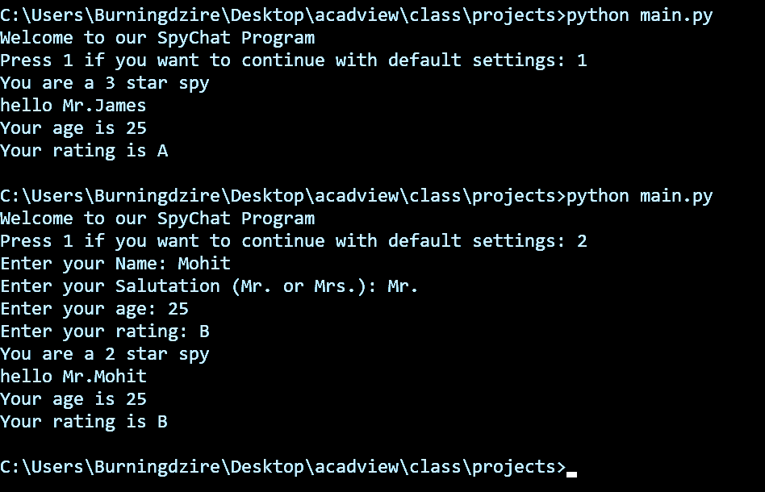
Result Should give this kind of output

Slide 40
Uploading the result on your github repo
Step 10: Once it is done, upload your code on github repository.

Slide 41
That’s all for now
Any Questions?

